Slide 1


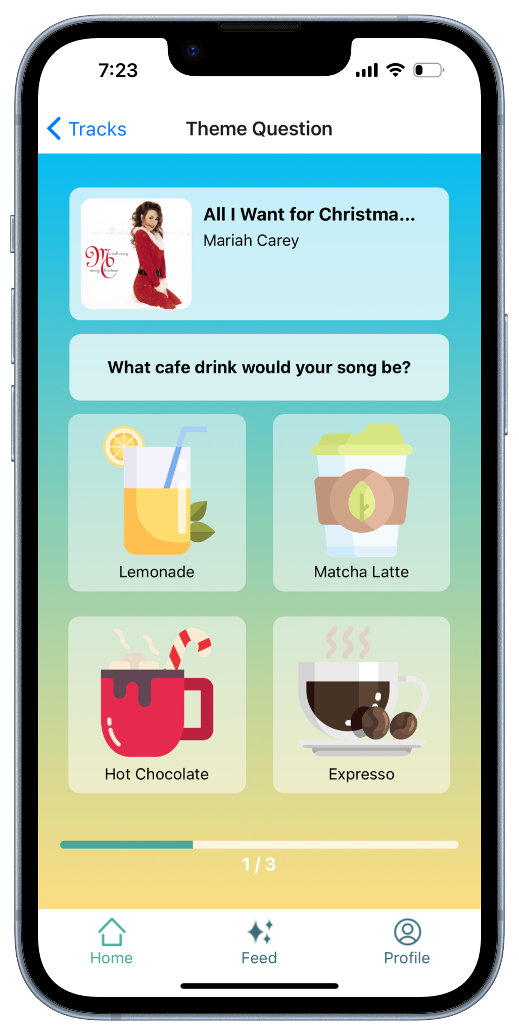
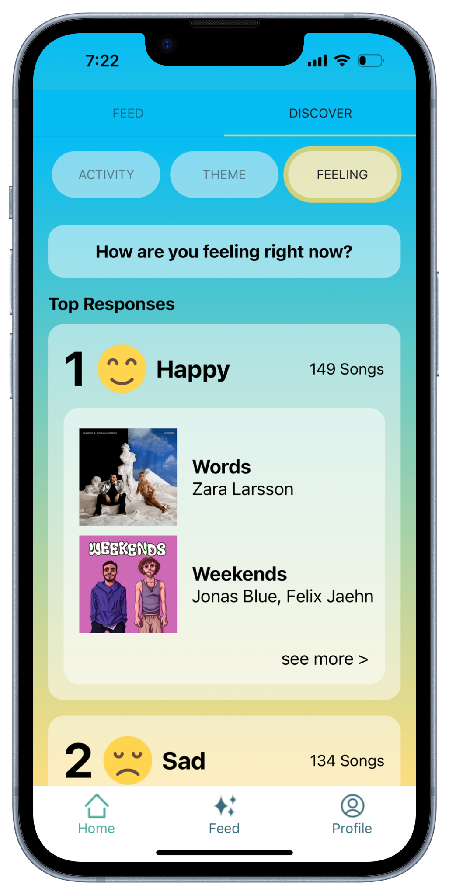
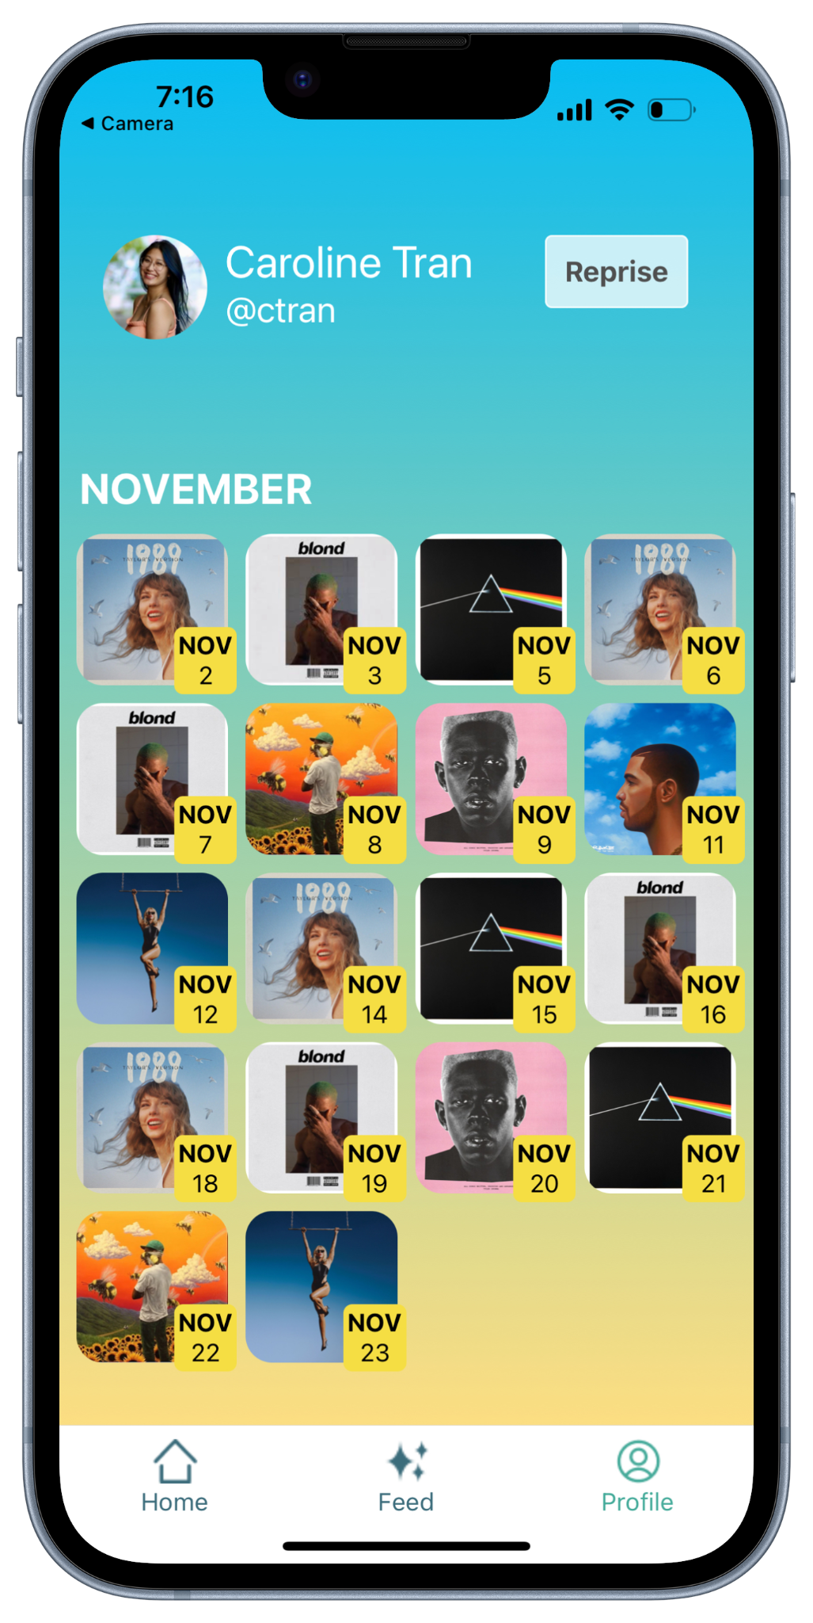



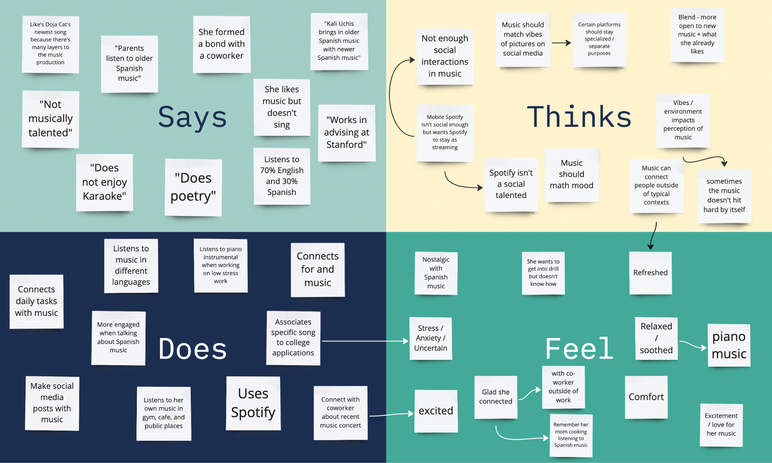
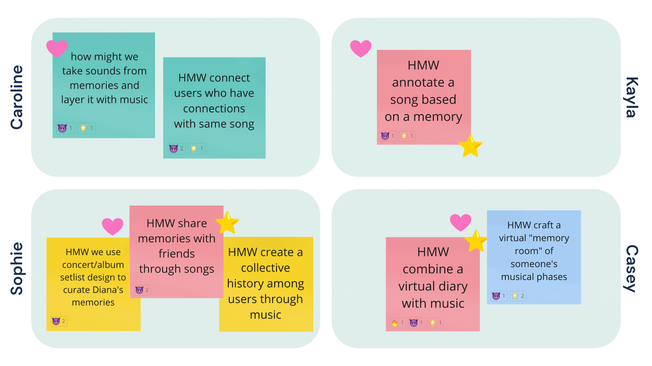
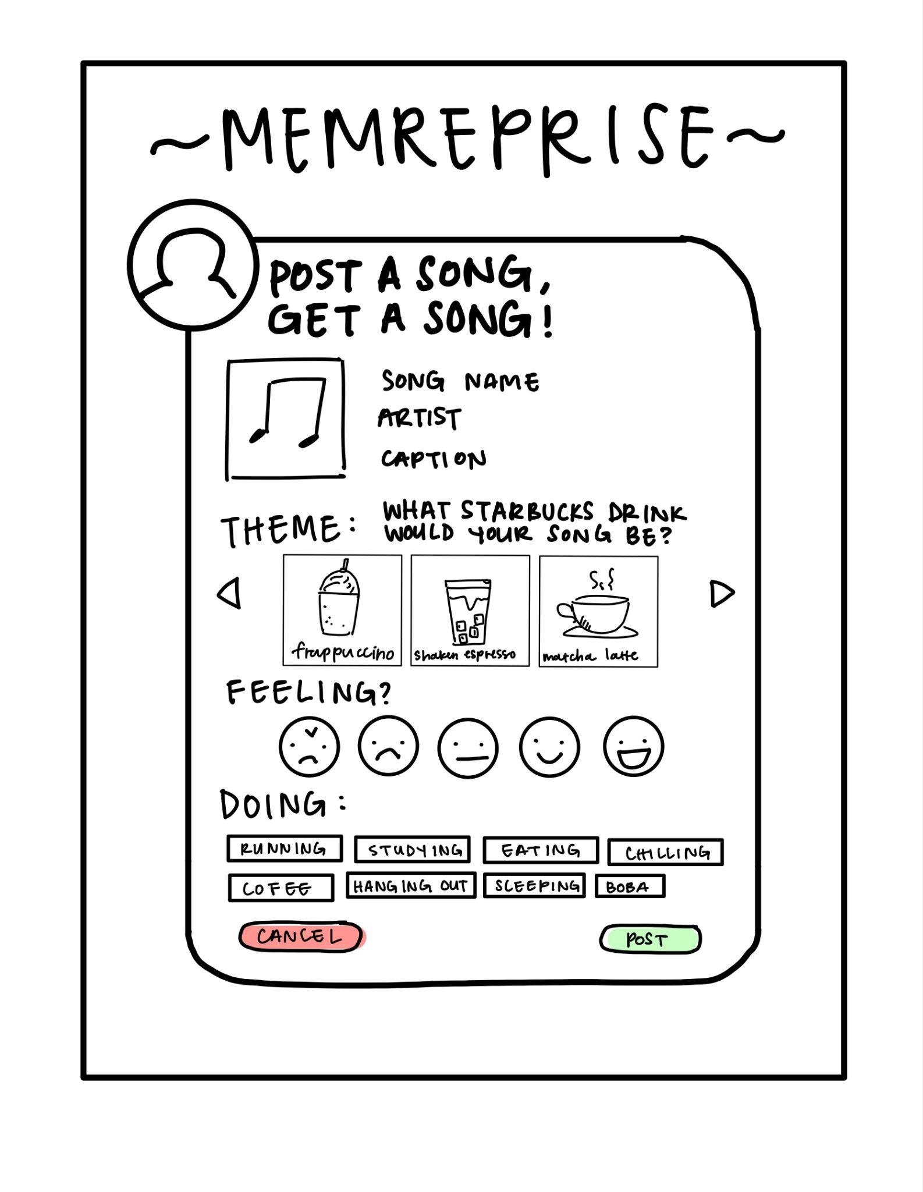
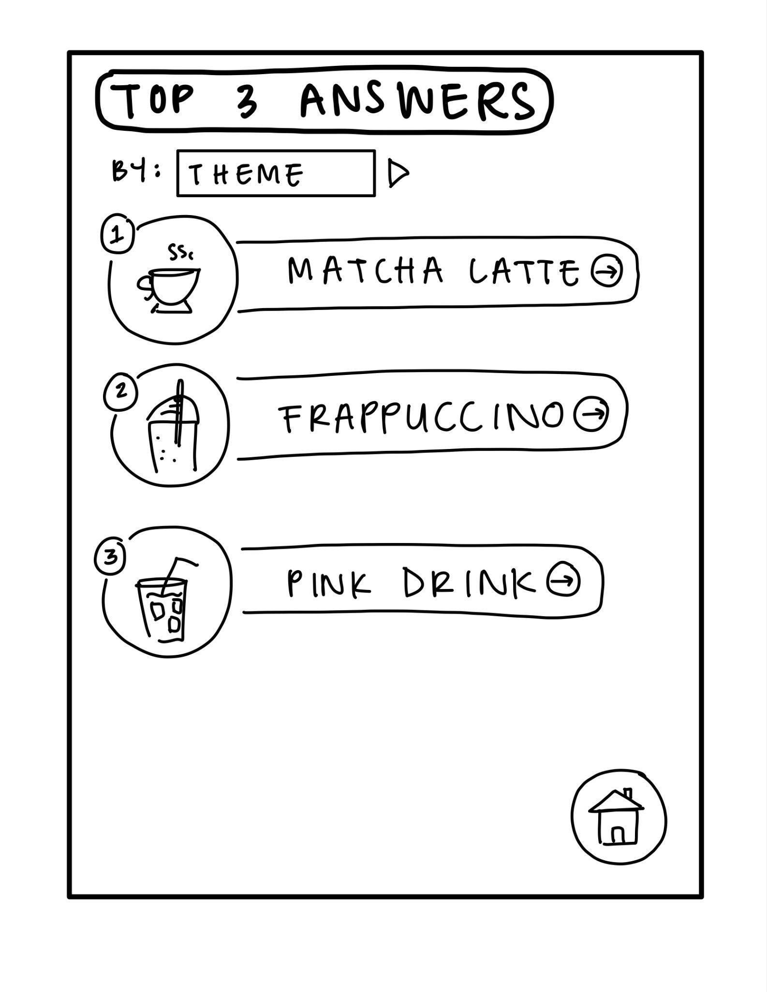
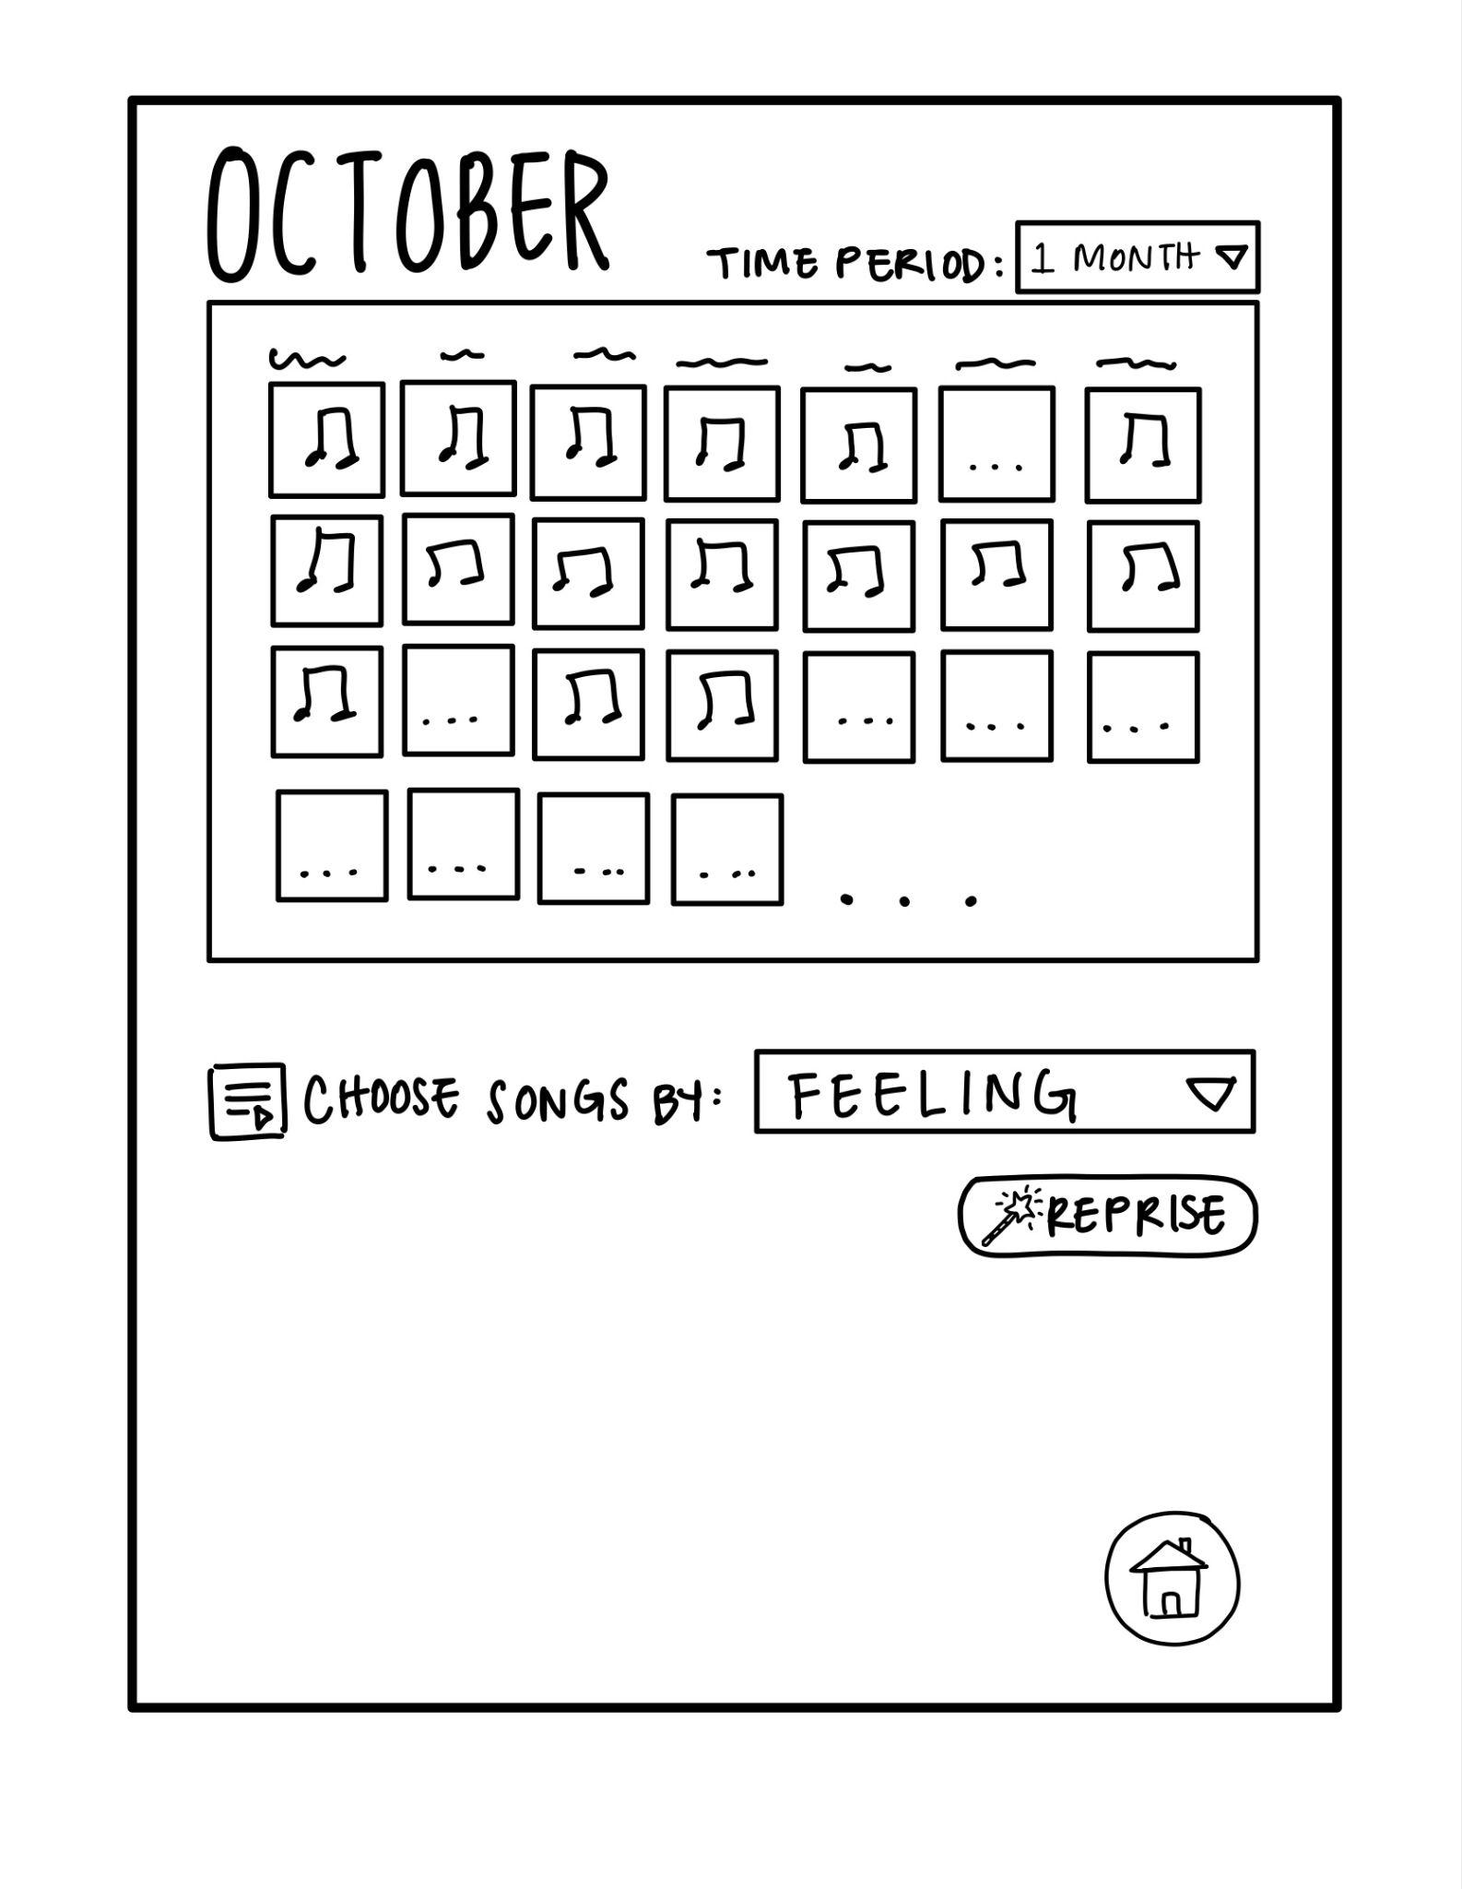
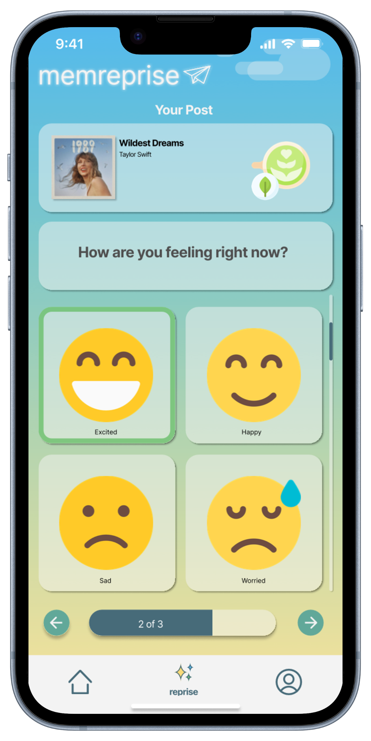
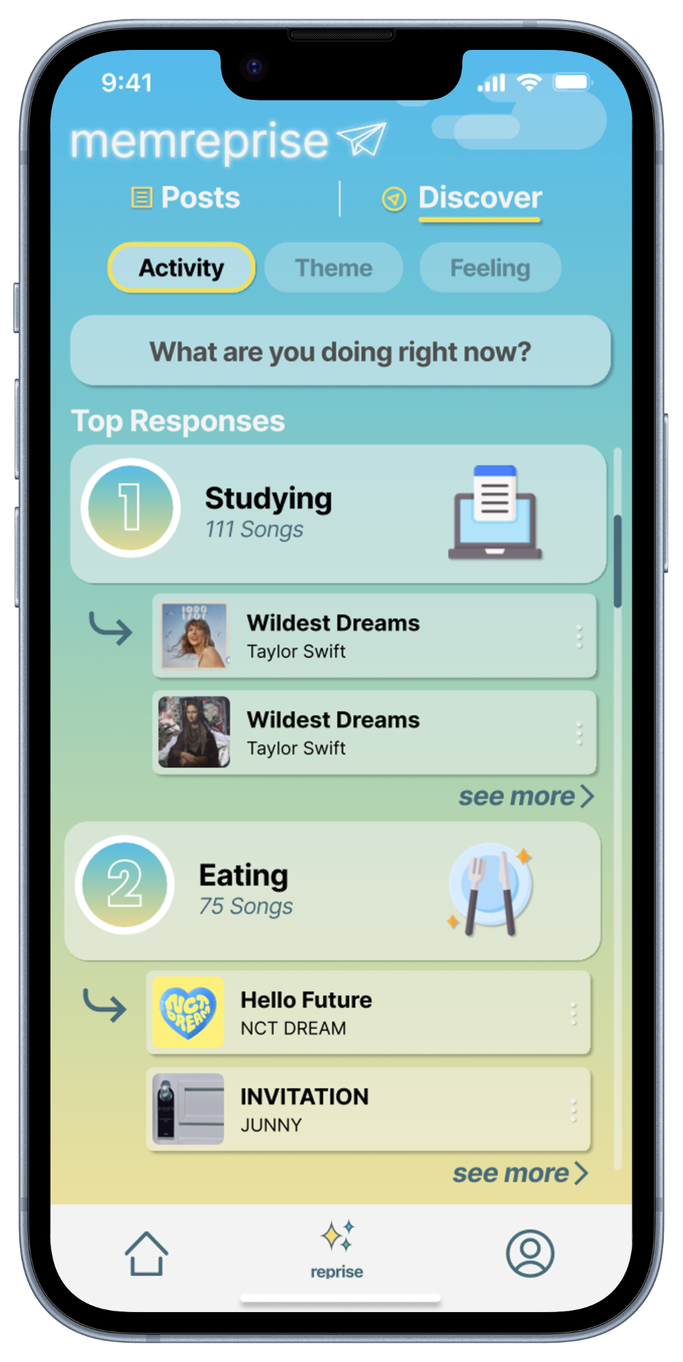
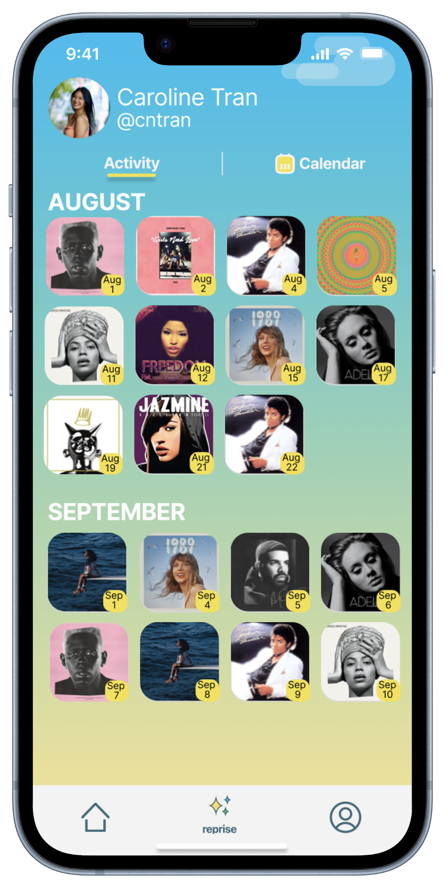
memreprise
where music and memories meet
Problem
Solution
People often have deep, yet hard-to-quantify associations with their favorite music.
Get a surprise notification daily! Log the song you are currently listening to and answer the question of the day.
Key Features
Create posts with themed questions of the day!
Discover new songs with curated playlists.
View and filter songs you previously listened to.
Design Iterations
Needfinding
2. Brainstorming
3. Low-Fi Prototype
4. Med-Fi Prototype
Casey N., Sophie W., Kayla P., Caroline T. | CS 147 Autumn 2023 | https://web.stanford.edu/class/cs147/projects/HarmoniousTies/MemReprise/
Notes:
Logo
Project title
Value proposition
Problem/solution
Key features (images of screens)
Design iterations
Team member names (first name, last initial)
CS 147 Autumn 2023
Project website URL of the form:

